Slide 1
Discrete Mathematics BCSC0010
Module 1
Relations (Lecture 7)

Slide 2
Binary Relation
Let A and B be non empty sets then any subset R of A x B is called a binary relation or relation from A to B.
Thus, R ⊆ AxB
Suppose R is a relation from A to B.
Then R is a set of ordered pairs (a,b) where a ∈ A and b ∈ B
If (a,b) ∈ R; we then say “a is R-related to b”, written aRb.
If (a,b) ∉ R; we then say “a is not R-related to b”, written aRb.
R={(a,b):a∈ A, b∈ B and aRb}

Slide 3
Example
Let A={1,2,5} and B={2,4}
Then , AxB={(1,2),(1,4),(2,2),(2,4),(5,2),(5,4)}
If Relation from A to B is expressed by statement “is less than” then
R={(1,2),)(1,4),(2,4)}

Slide 4
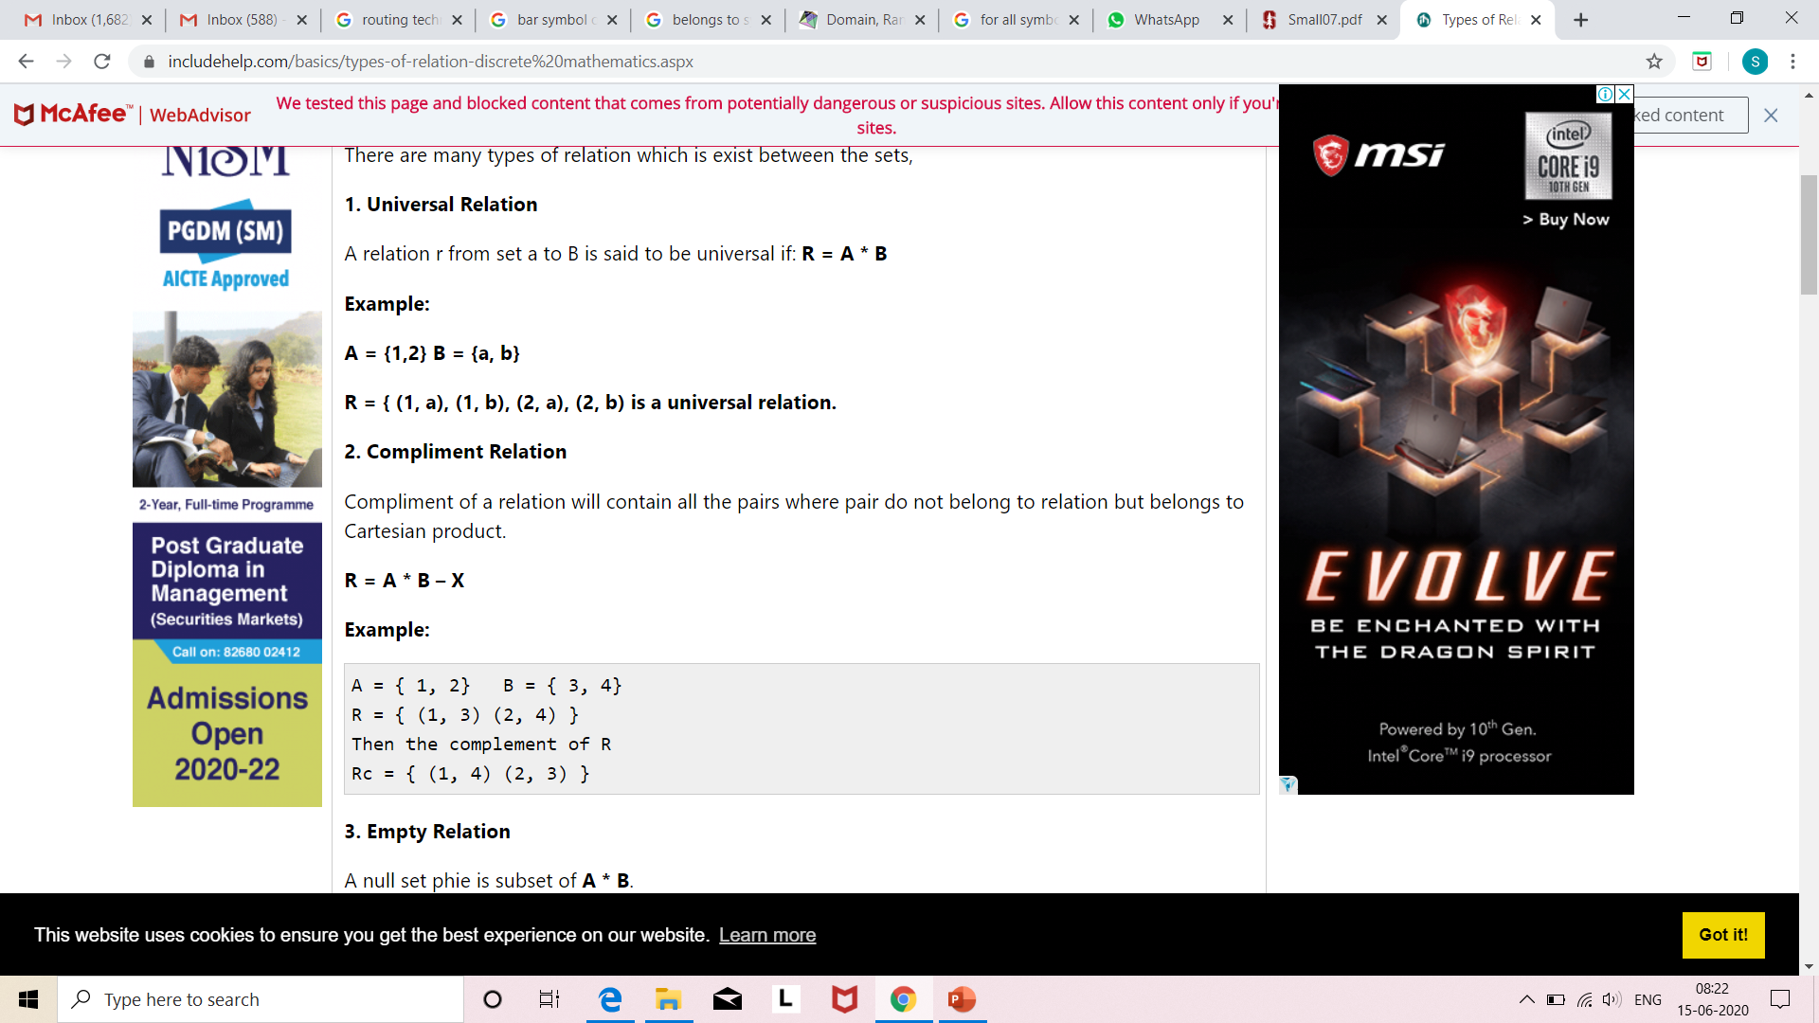
Complement of a relation
Complement of a relation will contain all the pairs where pair do not belong to relation but belongs to Cartesian product.
Ref:https://www.includehelp.com/basics/types-of-relation-discrete%20mathematics.aspx

Slide 5
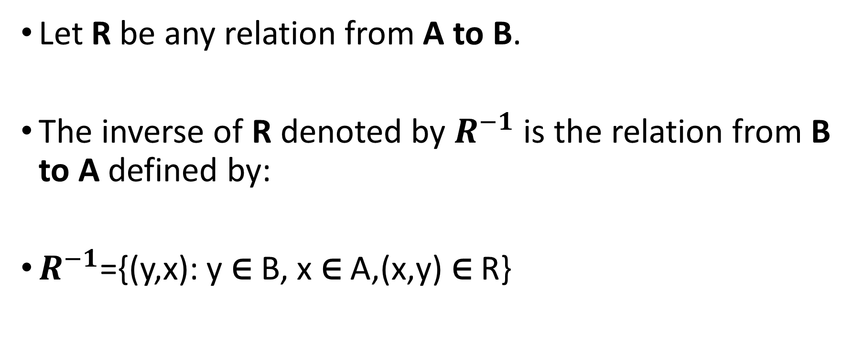
Inverse of a Relation
Let R be any relation from A to B.
The inverse of R denoted by $R^{−1}$is the relation from B to A defined by:
$R^{−1}$={(y,x): y ∈ B, x ∈ A,(x,y) ∈ R}

Slide 6
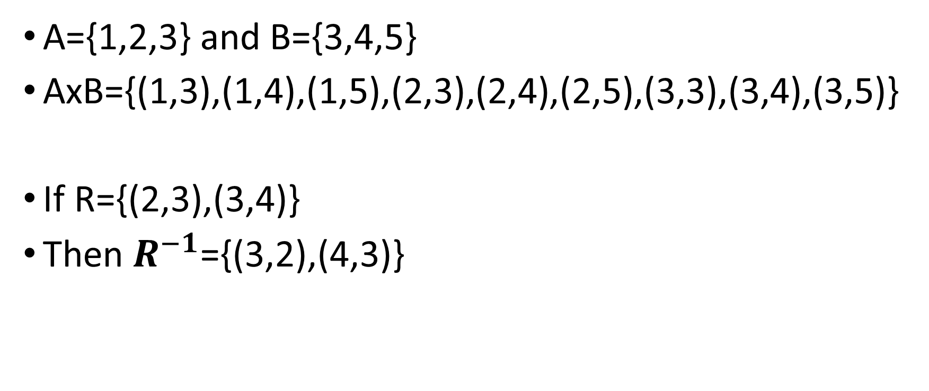
Example
A={1,2,3} and B={3,4,5}
AxB={(1,3),(1,4),(1,5),(2,3),(2,4),(2,5),(3,3),(3,4),(3,5)}
If R={(2,3),(3,4)}
Then $R^{−1}$={(3,2),(4,3)}

Slide 7
Properties of Relations
Reflexive Relation
Irreflexive Relation
Symmetric Relation
Transitive Relation

Slide 8
Reflexive Relation
A reflexive relation is the one in which every element maps to itself.
A relation R on a set A is called reflexive if (a, a) ∈ R for every element a ∈ A.
Example
Let A = {1, 2}
If R = {(1, 1), (2, 2), (1, 2), (2, 1)}
Then it will be a Reflexive relation.

Slide 9
Example
Consider the following relations on {1, 2, 3, 4}:
R1 = {(1, 1),(1,2),(2, 1),(2,2),(3,4),(4, 1), (4,4)}
R2 = {(1, 1),(1,2),(2, 1)}
R3 = {(1, 1),(1,2),(1,4),(2, 1),(2,2),(3,3),(4, 1), (4,4)}
R4 = {(2, 1), (3,1), (3, 2), (4,1), (4, 2), (4, 3)}
R5 = {(1, 1), (1, 2), (1, 3), (1,4), (2, 2), (2,3), (2, 4), (3, 3), (3, 4), (4, 4)}
R6 = {(3, 4)}
Which of these relations are reflexive?
Contd..

Slide 10
Solution
The relations R3 and R5 are reflexive because they both contain all pairs of the form (a, a), namely, (1, 1), (2, 2), (3, 3), and (4, 4).
The other relations are not reflexive because they do not contain all of these ordered pairs.
In particular, R1, R2, R4, and R6 are not reflexive because
(3, 3) is not in any of these relations.

Slide 11
Irreflexive Relation
A binary relation is called irreflexive, or anti-reflexive, if it doesn't relate any element to itself.
Example is the "greater than" relation (x > y) on the real numbers.
A relation is irreflexive if: (a, a) ∉ R, ∀ a ∈ A

Slide 12
Symmetric Relation
A relation R on a set A is called symmetric if (b, a) ∈ R whenever (a, b) ∈ R, for ∀ a, b ∈ A
The relation R on the set A is symmetric if
∀a∀b((a, b) ∈ R →(b, a) ∈ R)

Slide 13
Example
Consider the following relations on {1, 2, 3, 4}:
R1 = {(1, 1),(1,2),(2, 1),(2,2),(3,4),(4, 1), (4,4)}
R2 = {(1, 1),(1,2),(2, 1)}
R3 = {(1, 1),(1,2),(1,4),(2, 1),(2,2),(3,3),(4, 1), (4,4)}
R4 = {(2, 1), (3,1), (3, 2), (4,1), (4, 2), (4, 3)},
R5 = {(1, 1), (1, 2), (1, 3), (1,4), (2, 2), (2,3), (2, 4), (3, 3), (3, 4), (4, 4)}
R6 = {(3, 4)}
Here, R2 and R3 are symmetric

